Slide 1
Uncertainty Propagation
NEIL LAWRENCE
UNIVERSITY OF SHEFFIELD
@lawrennd
Notes:
Challenges
Introduce self
Alphago impressive but requires heavy compute.
More games of go than any human
And yet still Lee managed to win a match.

Slide 2
GLOBAL INFORMATION STORAGE CAPACITY IN OPTIMALLY COMPRESSED BYTES
SVMs
dominate
NIPS
ConvNets
Developed
Notes:
Superhuman performances are being driven by ML
Vision, Speech, Translation
Lots of process, but driven by availability of data.
Methodologies have not progressed a great deal since late 1990s

Slide 3
Notes:
Historical Analogy
Thomas Newcomen South West England
1712 Steam Engine

Slide 4
Coal
Google
Facebook
Amazon
Tin
Startups

Slide 5
Notes:
People and entire fields are passed by.

Slide 6
Notes:
James Watt Separate Condensor 1760s

Slide 7
Outline of the DeepFace architecture. A front-end of a single convolution-pooling-convolution filtering on the rectified input, followed by three locally-connected layers and two fully-connected layers. Color illustrates feature maps produced at each layer. The net includes more than 120 million parameters, where more than 95% come from the local and fully connected layers.
Source: DeepFace
Notes:
Modern Inference Engine
120 million parameters, 1 billion images, near human performance

Slide 8











$\text{g}\left(x\right)$
${\text{f}}_{1}(x)$
${\text{f}}_{2}(∙)$
${\text{f}}_{3}(∙)$
${\text{f}}_{4}(∙)$
${\text{f}}_{5}(∙)$
${\text{f}}_{6}(∙)$
${\text{f}}_{7}(∙)$
${\text{f}}_{8}(∙)$
${\text{f}}_{9}(∙)$
$\text{g}\left(x\right)={\text{f}}_{9}({\text{f}}_{8}({\text{f}}_{7}({\text{f}}_{6}(⋯))))$

Slide 9
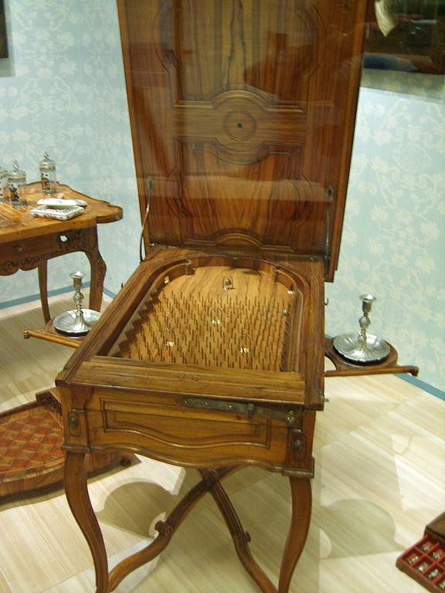
Notes:
Internal structure of the machine like layers of pins
Initial state of machine.
Moving pins around to fix

Slide 10

$f_{9}\left(\text{h}\right)=\left[\begin{matrix}φ\left(\sum_{i}{w_{1i}h_{i}}\right) \\ \begin{aligned}φ\left(\sum_{i}{w_{2i}h_{i}}\right) \\ ⋮\end{aligned} \\ φ\left(\sum_{i}{w_{ki}h_{i}}\right)\end{matrix}\right]$

Slide 11


$f_{9}\left(\text{h}\right)=\text{ϕ}\left(\text{Wh}\right)$
$$\text{W}∈ℜ^{k_{8}×k_{9}}$$

Slide 12





$x$
$$\text{ϕ}\left({\text{W}}_{1}x_{1}\right)$$
$$\text{ϕ}\left({\text{W}}_{2}h_{1}\right)$$
$$\text{ϕ}\left({\text{W}}_{3}h_{2}\right)$$
$$y$$
Yes
No

Slide 13
$x$
$$\text{ϕ}\left({\text{W}}_{1}x_{1}\right)$$
$$\text{ϕ}\left({\text{W}}_{2}h_{1}\right)$$
$$\text{ϕ}\left({\text{W}}_{3}h_{2}\right)$$
$$y$$
Yes
No

Slide 14
B
A
Notes:
All possible paths!

Slide 15



$g(x)$
$$\int{g\left(x\right)p\left(x\right)dx}$$
$$\frac{dg(x)}{dx}$$

Slide 16
Gaussian Processes

Slide 17






Gaussian Processes
$$x_{1},y_{1}$$
$${x_{2},y}_{2}$$
$$p\left(f | x\right)$$
$$p\left(y_{1}|f_{1}\right)$$
$$p\left(f|y,x\right)$$
$$p\left(y_{2}|f_{2}\right)$$

Slide 18

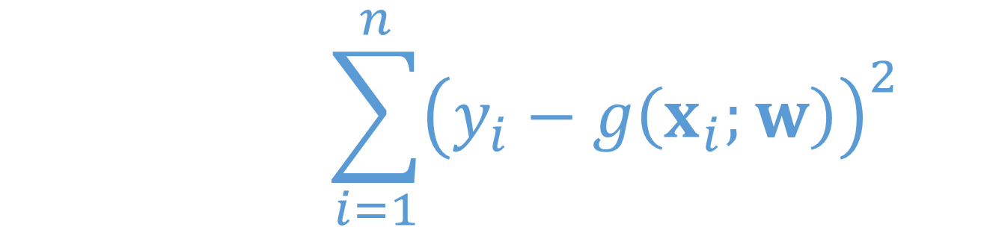
$$E\left(w\right)=\sum_{i=1}^{n}{{\left(y_{i}−g\left(x_{i};w\right)\right)}^{2}}$$
$$\log{p\left(y | w,x\right)}=\frac{1}{2σ^{2}}\sum_{i=1}^{n}{{\left(y_{i}−g\left(x_{i};w\right)\right)}^{2}+\frac{n}{2}\log{{2πσ}^{2}}}$$

Slide 19


$$p\left(y,w | x\right)=p\left(y | w,x\right)p\left(w\right)$$
$$x$$
w
y
$$p\left(y|x\right)=∫p\left(y | w,x\right)p(w)dw$$

Slide 20



$$x$$
$$p\left(y,f | x\right)=p\left(y | f\right)p\left(f | x\right)$$
f
y
$$p\left(y|x\right)=∫p\left(y | f\right)p\left(f | x\right)df$$

Slide 21





$$\log{p\left(y | x\right)}≥∫q\left(w\right)\log{\frac{p\left(y | w,x\right)p\left(w\right)}{q\left(w\right)}dw}$$
$$ℒ\left(y | x\right)=∫q\left(w\right)\log{\frac{p\left(y | w,x\right)p\left(w\right)}{q\left(w\right)}dw}$$
$$\log{p\left(y | x\right)}$$
$$KL\left(q\left(w\right) | p\left(w | y,x\right)\right)$$
$$ℒ\left(y | x\right)$$

Slide 22
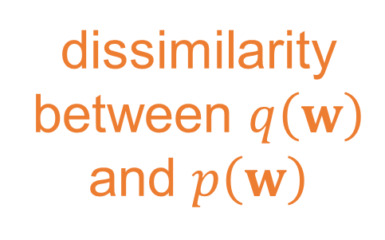
dissimilarity between $q\left(w\right)$ and $p\left(w\right)$
expected
log likelihood
$$ℒ\left(y | x\right)={\left\langle \log{p\left(y | w,x\right)}\right\rangle }_{q\left(w\right)}−KL\left(q\left(w\right)|p(w)\right)$$

Slide 23


$$x$$
$$p\left(y,f,u\right)=p\left(y | f\right)p\left(f | u\right)p\left(u\right)$$
$$p\left(y,f,u\right)=p\left(y | f\right)p\left(u | f\right)p\left(f\right)$$
$$x$$
u
f
y
u
$p\left(y|u\right)p(u)=∫p\left(y | f\right)p\left(f | u\right)dfp(u)$

Slide 24



$$p\left(y | u\right)=N\left(y | m, C+σ^{2}I\right)$$
$$C=K_{ff}−K_{fu}K_{uu}^{−1}K_{uf}$$
$$m=K_{fu}K_{uu}^{−1}u$$

Slide 25


$$y, f, u \sim N\left(0,\left[\begin{matrix}K_{ff}+σ^{2}I & K_{ff} & K_{ff} \\ K_{ff} & K_{ff} & K_{fu} \\ K_{uf} & K_{uf} & K_{uu}\end{matrix}\right]\right)$$
$$f, u \sim N\left(0, \left[\begin{matrix}K_{ff} & K_{fu} \\ K_{uf} & K_{uu}\end{matrix}\right]\right)$$

Slide 26

$$p\left(y | u\right)≥\prod_{i1}^{n}{\exp{∫{p\left(f_{i} | u\right)log p\left(y_{i} | f_{i}\right)df}}}$$

Slide 27

Standard parametric model
w
y
$p\left(y|w\right)p(w)$

Slide 28

$$p\left(y | u\right)≥N\left(y | m, σ^{2}I\right)\exp{c_{ii}}$$
$$C=K_{ff}−K_{fu}K_{uu}^{−1}K_{uf}$$
$$m=K_{fu}K_{uu}^{−1}u$$

Slide 29




$$C=K_{ff}−K_{fu}K_{uu}^{−1}K_{uf}$$
$$E\left(w\right)=\sum_{i=1}^{n}{{\left(y_{i}−g\left(x_{i};w\right)\right)}^{2}}$$
$$m=K_{fu}K_{uu}^{−1}u$$
$$p\left(y | u\right)=N\left(y | K_{fu}K_{uu}^{−1}u, K_{ff}−K_{fu}K_{uu}^{−1}K_{uf}+σ^{2}I\right)$$
$$p\left(y | u\right)=N\left(y | m, C+σ^{2}I\right)$$
$$p\left(y | u\right)≥\prod_{i1}^{n}{\exp{{\left\langle \log{p\left(y_{i} | f_{i}\right)}\right\rangle }_{p\left(f_{i} | u\right)}}}$$

Slide 30

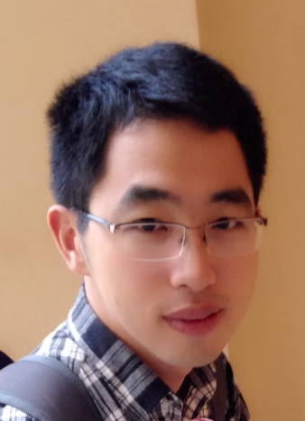

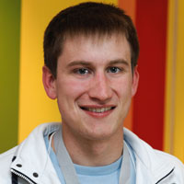
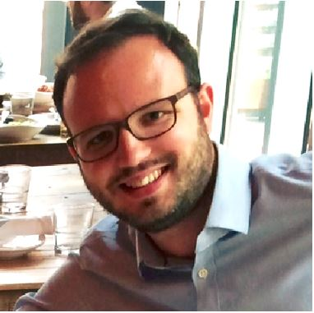
Health
Complex system
Scarce data
Different modalities
Poor understanding of mechanism
Large scale
genotype
environment
epigenotype
State of health
clinical tests
gene expression
Organ states
treatment
clinical notes
Cell states
survival analysis
PLoS Comp Bio, Nature Methods
biopsy
X-ray
biopsy
X-ray

Slide 31


Slide 32
Thank you
Neil Lawrence
http://inverseprobability.com
@lawrennd
Notes:
Thank you.

